Slide 1


THE PEOPLE BEHIND BIRT THE PEOPLE BEHIND BIRT THE PEOPLE BEHIND BIRT THE PEOPLE BEHIND BIRT THE PEOPLE BEHIND BIRT THE PEOPLE BEHIND BIRT THE PEOPLE BEHIND BIRT THE PEOPLE BEHIND BIRT THE PEOPLE BEHIND BIRT THE PEOPLE BEHIND BIRT THE PEOPLE BEHIND BIRT THE PEOPLE BEHIND BIRT THE PEOPLE BEHIND BIRT THE PEOPLE BEHIND BIRT THE PEOPLE BEHIND BIRT THE PEOPLE BEHIND BIRT THE PEOPLE BEHIND BIRT THE PEOPLE BEHIND BIRT THE PEOPLE BEHIND BIRT THE PEOPLE BEHIND BIRT THE PEOPLE BEHIND BIRT THE PEOPLE BEHIND BIRT THE PEOPLE BEHIND BIRT THE PEOPLE BEHIND BIRT THE PEOPLE BEHIND BIRT THE PEOPLE BEHIND BIRT THE PEOPLE BEHIND BIRT THE PEOPLE BEHIND BIRT THE PEOPLE BEHIND BIRT THE PEOPLE BEHIND BIRT THE PEOPLE BEHIND BIRT THE PEOPLE BEHIND BIRT THE PEOPLE BEHIND BIRT THE PEOPLE BEHIND BIRT THE PEOPLE BEHIND BIRT THE PEOPLE BEHIND BIRT THE PEOPLE BEHIND BIRT THE PEOPLE BEHIND BIRT THE PEOPLE BEHIND BIRT THE PEOPLE BEHIND BIRT THE PEOPLE BEHIND BIRT THE PEOPLE BEHIND BIRT THE PEOPLE BEHIND BIRT THE PEOPLE BEHIND BIRT THE PEOPLE BEHIND BIRT THE PEOPLE BEHIND BIRT THE PEOPLE BEHIND BIRT THE PEOPLE BEHIND BIRT THE PEOPLE BEHIND BIRT THE PEOPLE BEHIND BIRT THE PEOPLE BEHIND BIRT THE PEOPLE BEHIND BIRT THE PEOPLE BEHIND BIRT THE PEOPLE BEHIND BIRT THE PEOPLE BEHIND BIRT THE PEOPLE BEHIND BIRT THE PEOPLE BEHIND BIRT THE PEOPLE BEHIND BIRT THE PEOPLE BEHIND BIRT THE PEOPLE BEHIND BIRT THE PEOPLE BEHIND BIRT THE PEOPLE BEHIND BIRT THE PEOPLE BEHIND BIRT THE PEOPLE BEHIND BIRT THE PEOPLE BEHIND BIRT THE PEOPLE BEHIND BIRT THE PEOPLE BEHIND BIRT THE PEOPLE BEHIND BIRT THE PEOPLE BEHIND BIRT THE PEOPLE BEHIND BIRT THE PEOPLE BEHIND BIRT THE PEOPLE BEHIND BIRT THE PEOPLE BEHIND BIRT THE PEOPLE BEHIND BIRT THE PEOPLE BEHIND BIRT THE PEOPLE BEHIND BIRT THE PEOPLE BEHIND BIRT THE PEOPLE BEHIND BIRT THE PEOPLE BEHIND BIRT THE PEOPLE BEHIND BIRT THE PEOPLE BEHIND BIRT THE PEOPLE BEHIND BIRT THE PEOPLE BEHIND BIRT THE

Slide 2

Who is BIRT? Solving Your Data Visualization Needs with Open Source
Rob Murphy
BIRT Evangelist
OEM Technical Account Manager, Actuate
Notes:
2
2

Slide 3

Today’s Agenda and Goals
Background
The Emergence of the BIRT Project
Getting to Know BIRT: Demo
Architecture and Extensibility
Market Adoption
Summary

Slide 4

Business Intelligence and Reporting
Purchase Orders
Account Transaction Histories
Most applications have some type of data visualization need…
And the simple problems are easy, but…
Real-world data visualization is challenging…
Gather the data
Perform calculations, sort, group, aggregate, total…
Present information professionally
…and meeting user demand is crucial to the success of an application
Budget Variance
Supplier Status
Sales Commision
Online and Printed Statements
Daily Work Order Task Lists
Shipping Manifests
Invoices
Defect Tracking
Network Outage Frequency
Assets Under Management
Utility Bills
360° Customer Views
Deviation from Service Level
Objectives
Sales
Commissions
Website Traffic Analysis

Slide 5
Traditional Approaches to the Problem
Crystal Reports
ReportNet
StyleReports
JReports
Closed-Source Commercial Products
Buy
Custom-Developed Solution
Build
Java
JSP
JFaces
HTML
XSLT
XML
JavaScript

Slide 6
Open Source Creates New Choices
Closed-Source Commercial Products
Buy
Open-Source-Based Products
Build using Open Source Code
Leverage Open Source in a Custom Solution
Open Source Products
Custom-Developed Solution
Build

Slide 7

Actuate Launches the BIRT Project
Actuate proposed and started
BIRT Business Intelligence and Reporting Tools Project
… a top-level Eclipse project
Actuate Joins Eclipse Foundation as Strategic Developer and Board Member
Adds BI and Reporting as Open Source Project
Professional open source Primary development resources funded by Actuate
Contributions from many sources IBM, Innovent Solutions and community
AUGUST 2004

Slide 8
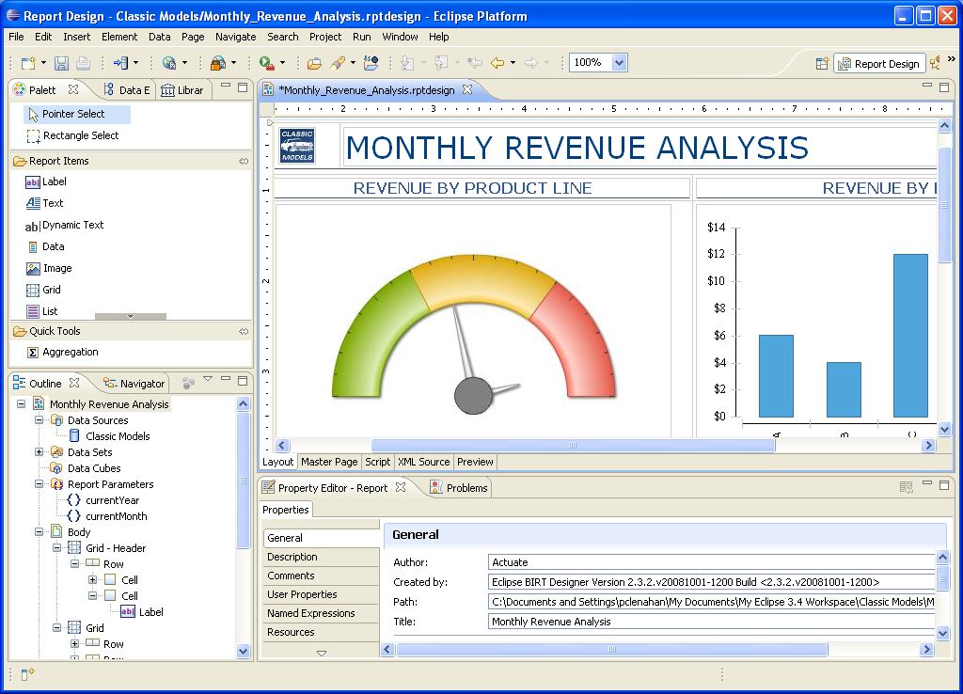
Business Intelligence and Reporting Tools
A New Generation of Data Visualization Technology
Makes all data-driven content development easy
Modern, web-page design metaphor
Open and standards-based
Flexible with rich programmatic control
Full support for libraries and reuse
Foundation for a range of solutions
Simplicity
that makes simple layouts easy
Power
to create very complex layouts
BIRT

Slide 9
BIRT Release History
Seven Major Releases since Project Launch
 | September 2004 |  | BIRT Project proposal accepted, and project launched
 | June 2005 | 1.0 | Eclipse Report Designer, Report Engine, Chart Engine
 | December 2005 | 2.0 | Support for a wide variety of common layouts
 | June 2006 | 2.1 | Advanced parameters, ability to join data sets, …
 | June 2007 | 2.2 | Dynamic crosstab support, web services data source, …
 | June 2008 | 2.3 | JavaScript Debugger, BiDi Support, Charts in Crosstabs, …
 | June 2009 | 2.5 | Page aggregates, Multiple drill-downs in Charts, …
 | June 2010 | 2.6 | New charts, more chart control, developer productivity, …
Ground-up initiative: Innovative approach to layout and design
Enterprise-class, designed to handle real-world problems
Developed in the open with community feedback at all stages

Slide 10
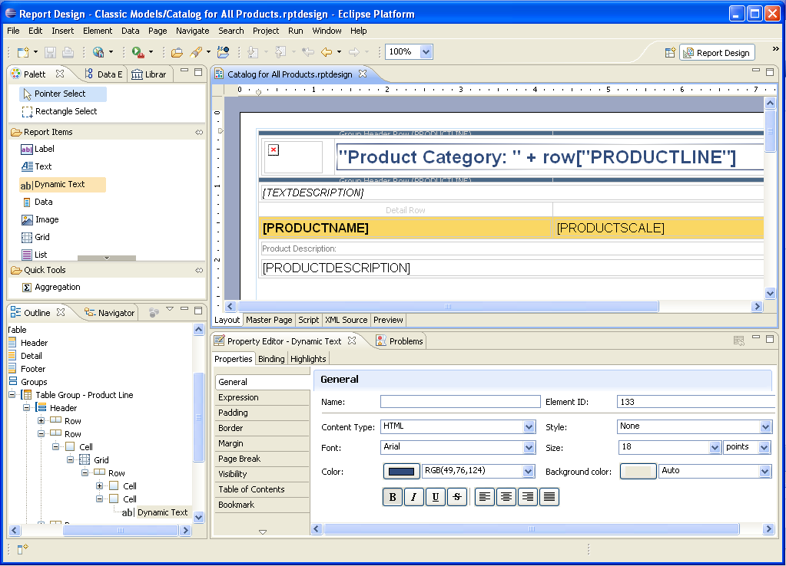

Getting to Know BIRT
DEMO

Slide 11
BIRT Example Key Capabilities
Very Simple to Very Complex Layouts
Listings, cross-tab, dashboard, pixel-perfect, charts …
Grouping, advanced aggregations, sub-totals, calculations
Multi-section and sub-reports
Conditional sections and logic
Full programmatic control/scripting
Embedded images…
Comprehensive Data Access
SQL databases, Web Services, Flat Files, XML, scripted data sources …
Multiple data sources in one design…
Output Formats
HTML, PDF, Excel, Word, PowerPoint…
Internationalization of labels and text
Bi-Directional language display
Re-use and Developer Productivity
Library support for publishing and sharing components
Leverages common standards (SQL, HTML, JavaScript, Java, XML)
Cascading Style Sheets
Built-in debugger…
Interactivity and Linking
Data driven hyperlinks
Drill-through charts and graphics…
Multiple Usage and Productivity Aids
Graphical layout and design
Query & metadata editors
Formatting Builder
Grouping Builder
Customizable cheat sheets and templates…

Slide 12
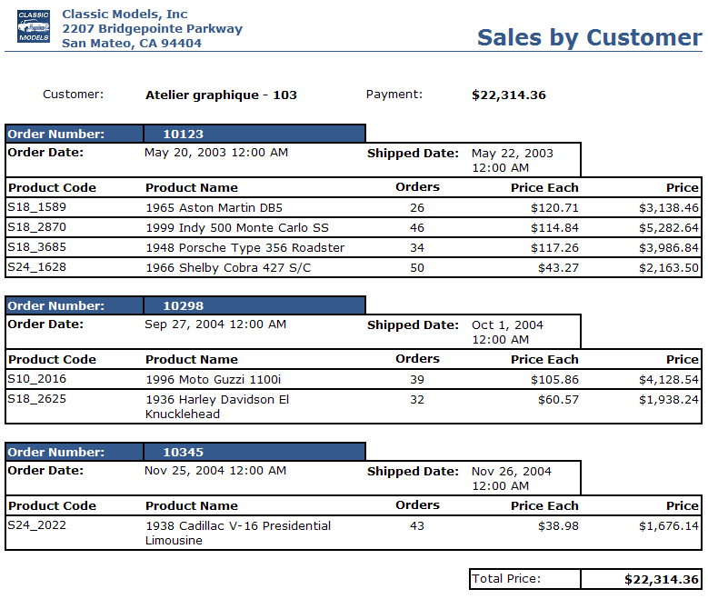
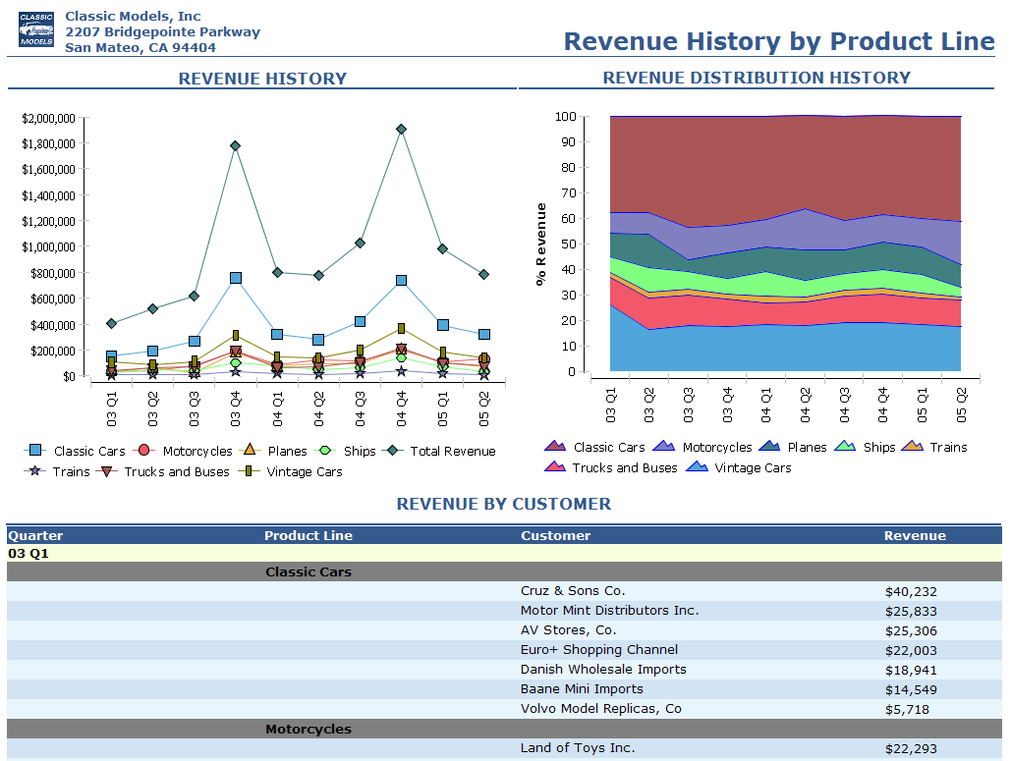
BIRT Design Gallery
Charts and Tables
Listing with Groups and Sub-Totals

Slide 13
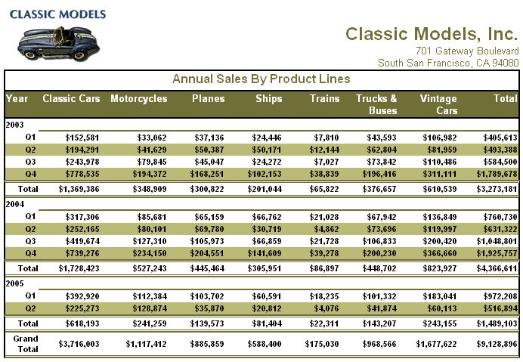
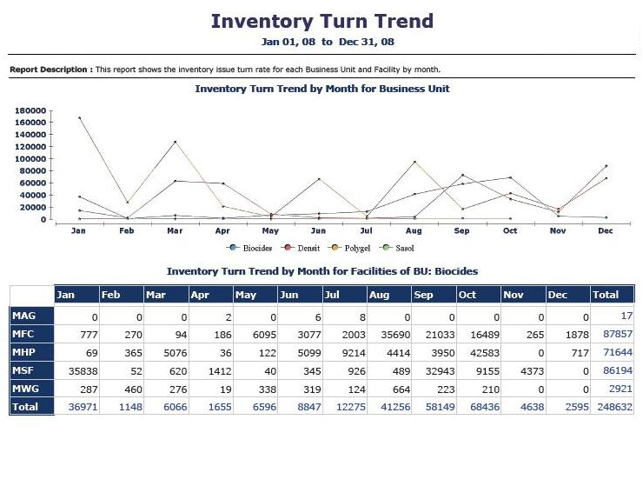
BIRT Design Gallery
Crosstab and Charts
Crosstabs

Slide 14
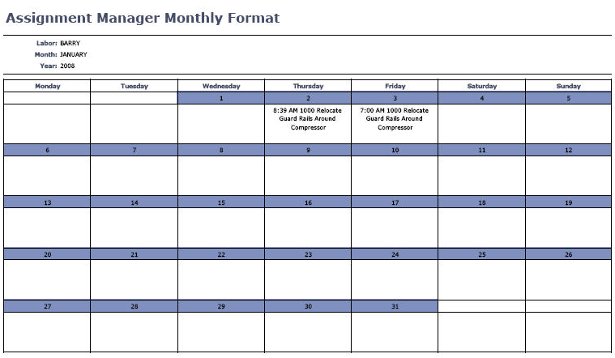
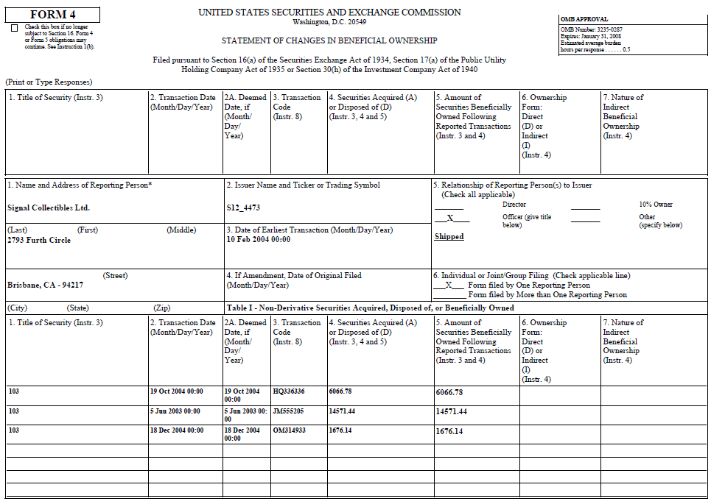
BIRT Design Gallery
Forms
Calendar / Schedule

Slide 15
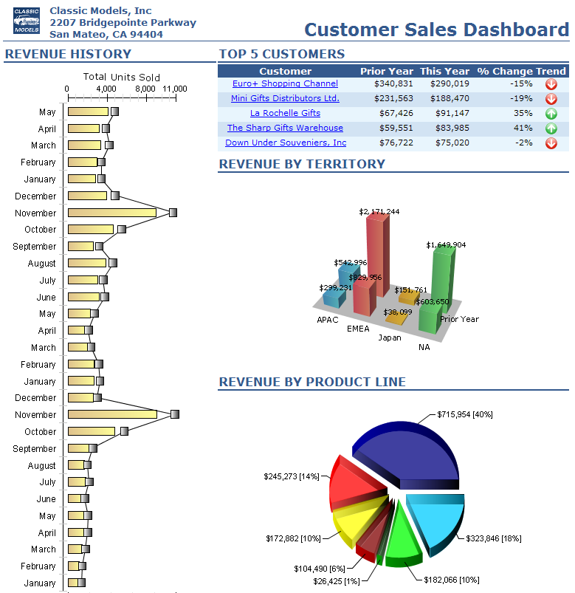
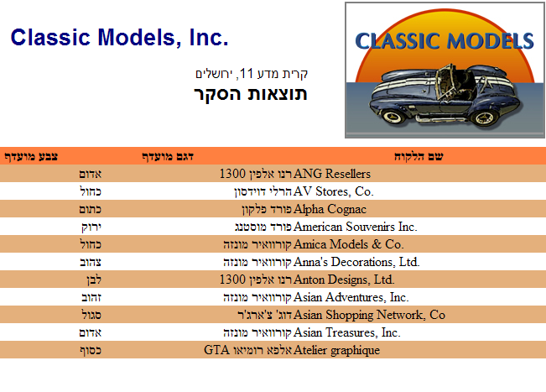
BIRT Design Gallery
Multi-Language and Bi-Directional
Dashboards

Slide 16
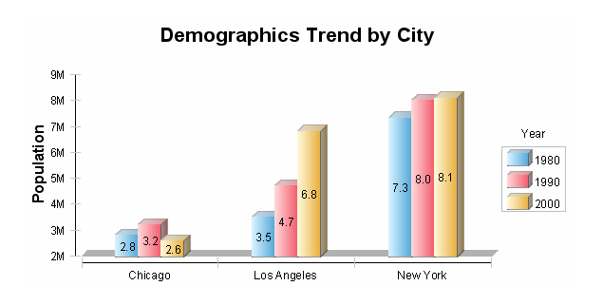
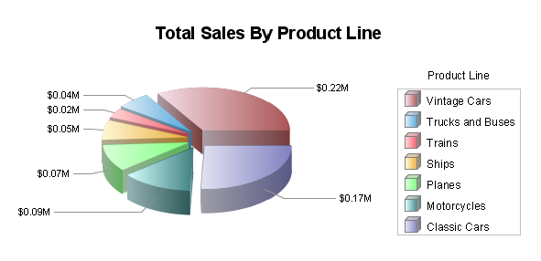
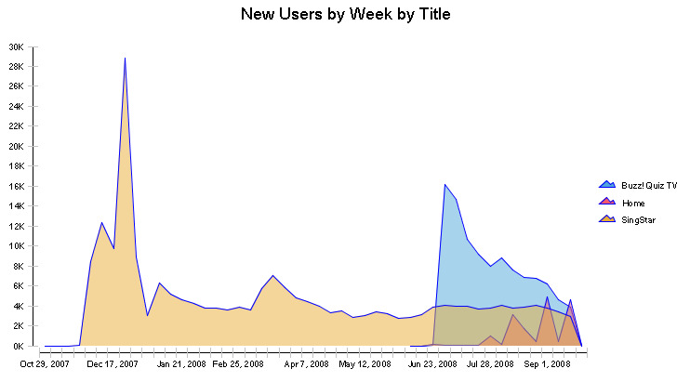
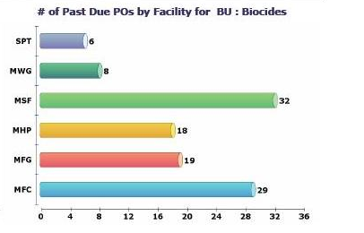
BIRT Chart Gallery

Slide 17
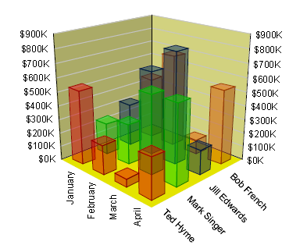
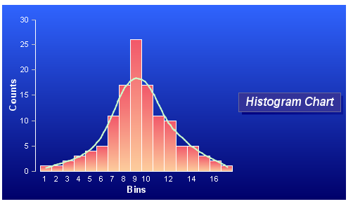
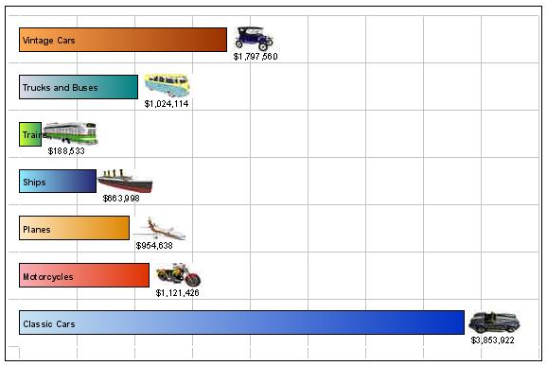
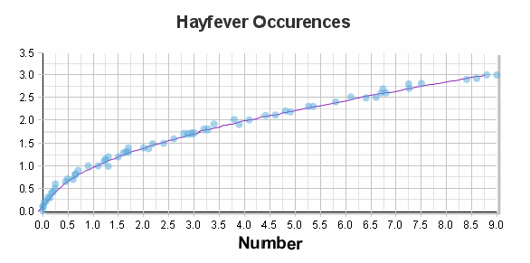
BIRT Chart Gallery

Slide 18
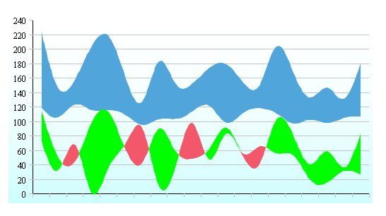
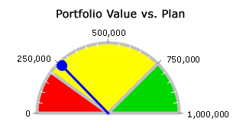
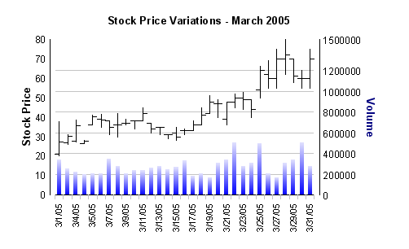
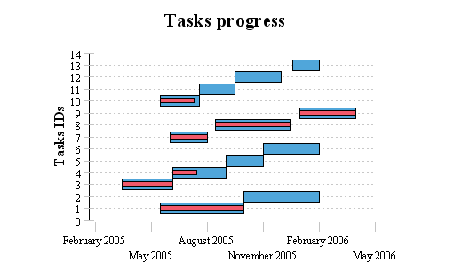
BIRT Chart Gallery

Slide 19
High-Level BIRT Architecture
BIRT Designer
Eclipse Designer
Eclipse
DTP,
WTP,…
Chart
Designer
Design Engine
XML Design
BIRT Engine
Document
Generation
Services
Charting
Engine
Data
Data
Services
Presentation
Services
HTML
PDF
Excel
Word
PowerPoint
PostScript
…
Data

Slide 20
APIs and Extension Points
Extensibility is a key principle of the BIRT Project
Data source extensibility
Application specific design-time query builders
Custom design-time and run-time data access
Custom business logic extensibility
Incorporate complex business logic scripting
Access existing and new Java code
Visualization extensibility
Build new visual data presentation ‘widgets’
Extend charting with new chart types; new output formats
Rendering content for output
Target output for specific devices and formats

Slide 21
High Level BIRT Architecture: APIs
BIRT Designer
Custom Designer UI
Eclipse
DTP,
WTP,…
Chart
Designer
Chart UI API
BIRT Engine
XML Design
Engine API
BIRT Engine
Document
Generation
Services
Charting
Engine
Scripting API
Chart Engine API
Data
Data
Services
Presentation
Services
HTML
PDF
Excel
Word
PowerPoint
PostScript
…
Data
Open Data Access
Emitter API

Slide 22
BIRT Momentum Huge BIRT Community
Cumulative BIRT Downloads
Thriving BIRT Community
Over 1M developers using BIRT in 157 countries
30+ conferences featured BIRT content worldwide in 2009
BIRT-Exchange.com
Professionally staffed forums
Extensive contributions
Marketplace applications
More than 10 million downloads through 2010
2004 2005 2006 2007 2008 2009 2010
BIRT technology is tried and tested in many applications

Slide 23




































BIRT Momentum Sample BIRT Adopters

Slide 24






BIRT Momentum Publications
BIRT: A Field Guide to Reporting 2nd Edition
Integrating and Extending BIRT 2nd Edition
Practical Data Analysis and Reporting with BIRT
Eclipse BIRT: Business Intelligence and Reporting Tool
BIRT for Beginners
BIRT Best Practices

Slide 25
BIRT Project Users
Easy Complex
 | AUDIENCE | FEATURES
 | Content and Report developers | Drag-and-drop authoring, charting
 | Advanced content developers | Scripting, script API
 | Runtime integration developers | BIRT Viewer and engine APIs
 | Custom design UI developers | Design engine API
 | Extension developers | BIRT extension points
 | Core development | Eclipse development, open source
Notes:
25

Slide 26

How is BIRT Being Used? BIRT Report Designer on Desktops
Use BIRT Designer as a desktop reporting solution
BIRT Report Designer
Usage Scenario
Desktop personal productivity tool
Users
Report developers
Advanced business users

Slide 27

How is BIRT Being Used? Integrated Data Visualization
Integrate Open Source BIRT Engine into application
Application
Integration Code
BIRT Engine
Usage Scenario
Add data visualization to applications
Users
ISV and Enterprise Application Developers
Java Developers, PHP Developers, …
Report Developers

Slide 28

How is BIRT Being Used? Business Intelligence
Leverage commercial deployment solution for BIRT
BIRT iServer
BIRT Engine
Usage Scenario
Automated content generation, distribution
Interactivity, security, …
Users
Content and report developers
Business users

Slide 29
Actuate BIRT Technology Family Complementing and Extending Eclipse BIRT
Development Actuate BIRT Extensions Deployment
Development Tools
Skill-specific tools for developers and users
User Interactivity
Engage users with rich, interactive content
Deployment Tools
Manage, schedule, secure, run and distribute
High-Scale Distribution
Load-balanced, high availability for 100,000s of users
Eclipse BIRT
Meet core requirements

Slide 30
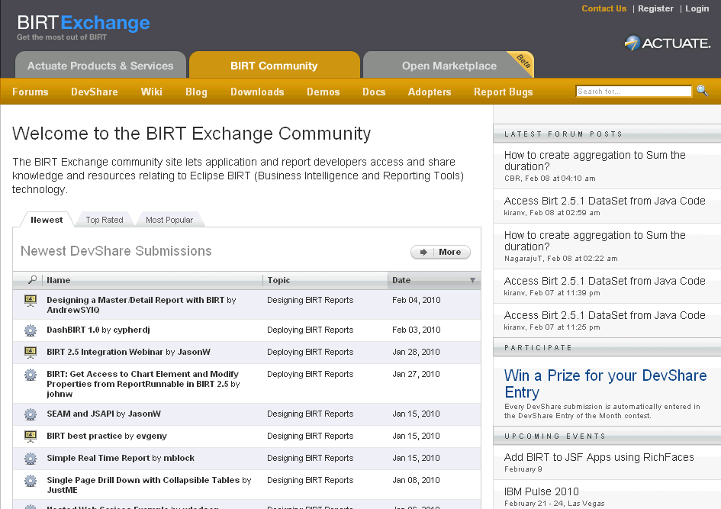
Resources BIRT Exchange Community Site
Centralized hub for BIRT developers
Access demos, tutorials, tips and techniques, documentation…
Enables developers to be more productive and build applications faster
Marketplace for applications
Explore
Search/sort
Rate, comment
Forums
Download
Documentation
Software
Examples
Contribute
BIRT designs, code
Technical tips
Applications
www.birt-exchange.com

Slide 31

Summary
A New Generation of Data Visualization Technology
Top-level open source Eclipse project
Free with commercial friendly license
Powerful, extensible data visualization technology
Easy-to-use, web-centric design metaphor
Very active community with more than 10 million downloads
Actuate extends and complements BIRT with value-added technology

Slide 32

Who is BIRT? Solving Your Data Visualization Needs with Open Source
Q & A
Notes:
32
32

